Slide 1
Music and Sensorimotor Coupling: What Music Is Groovy?
Zachary Brandt
Notes:
My name is Zachary Brandt, and this project is on classifying music as either groovy, or not groovy, and I know that sounds subjective, but what I mean when I say groovy, is that. . .

Slide 2
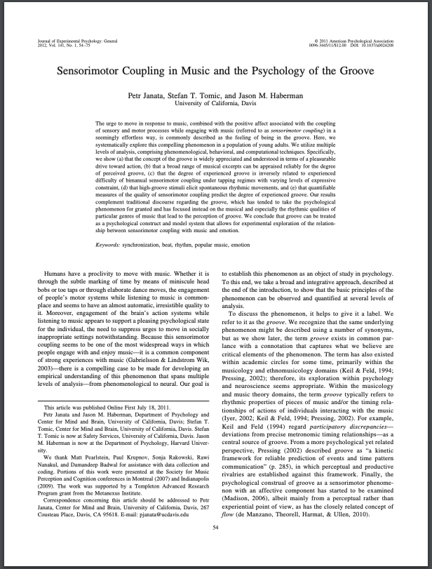
Some music allows for synchronous rhythmic entrainment
Toe tapping / head bobbing
148 Songs
Tempo between 90 & 120
High syncopation
Notes:
Certain types of music allows for synchronous rhythmic entrainment of the neurons in the auditory cortex, which manifests itself as head-bobbing or toe tapping, and this was shown in a study at UC Davis, and I just have the first page here on the right. The study used 148 songs, found that groovy songs had a sweet spot of tempo, and high syncopation in rhythm

Slide 3

Applying Groovy Classification to Spotify Database Using API
160,000+ Songs
Target Created from Thresholding Existing Features
Features
Duration
Instrumental-ness
Acoustic-ness
Live-ness
Release year
Major / minor
Happy / sad
Explicit / not
Target
Groovy or not Groovy
Notes:
I decided to take this further and apply the groovy classification to the spotify database of 160,000 songs, which already had the features tempo and danceability. I created my target of groovy by thresholding tempo and danceability to match the academic study’s standard, and classified the target using the remaining features such as duration, acousticness, Release year, and so on

Slide 4
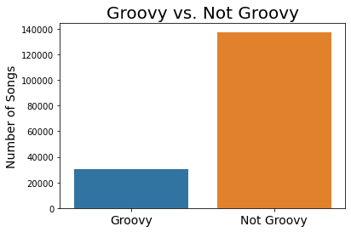
About 20% of the Spotify Data Set is “Groovy”
Notes:
After creating the target, I found that abut a fifth of the database’s songs meet the groovy standard, so I had to oversample and undersample to deal with this inbalance. And even after running 7 different models

Slide 5
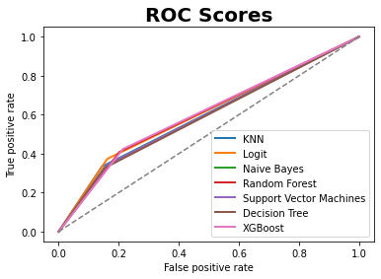
Modeling Is Not Great at Accurately Classifying, but Better than Nothing
Notes:
None of the models are great at classifying, but they are all better than just guessing. And while this may look bad, it actually isn’t the end of the world because we don’t need to know every single “groovy” song in the database…

Slide 6
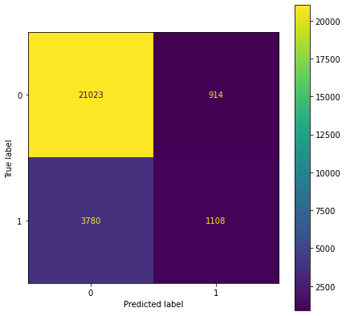
Random Forest Is Strongest Model for Accuracy on Test Data
Accuracy: 0.83
Precision: 0.55
Recall: 0.30
Notes:
Using the random forest model, which had the best test accuracy, we can see that it is not perfect, but we still have over a thousand true positives, which is great, except that we also have almost the same amount of false positives, hence the precision of .55

Slide 7
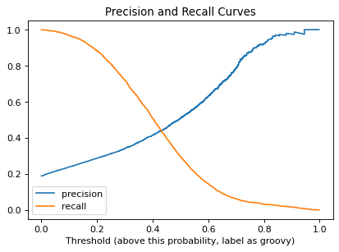
Want to Minimize False Positives, Focus on Precision
Bad music kills atmosphere
DJs or business owners will want the model to be precise
Can sacrifice recall
If only 200 songs, that is more than needed for a venue
16 Hours of music
Notes:
We want to get rid of the false positives and focus on precision, because clients do not want non groovy music coming out of the model. And we can get away with sacrificing recall, because even if we only get 200 songs out of the thousands possible, that is still more than enough for their needs, because venues won’t need 16 hours of music. So we can increase our threshold to say .7 and accomplish this.

Slide 8
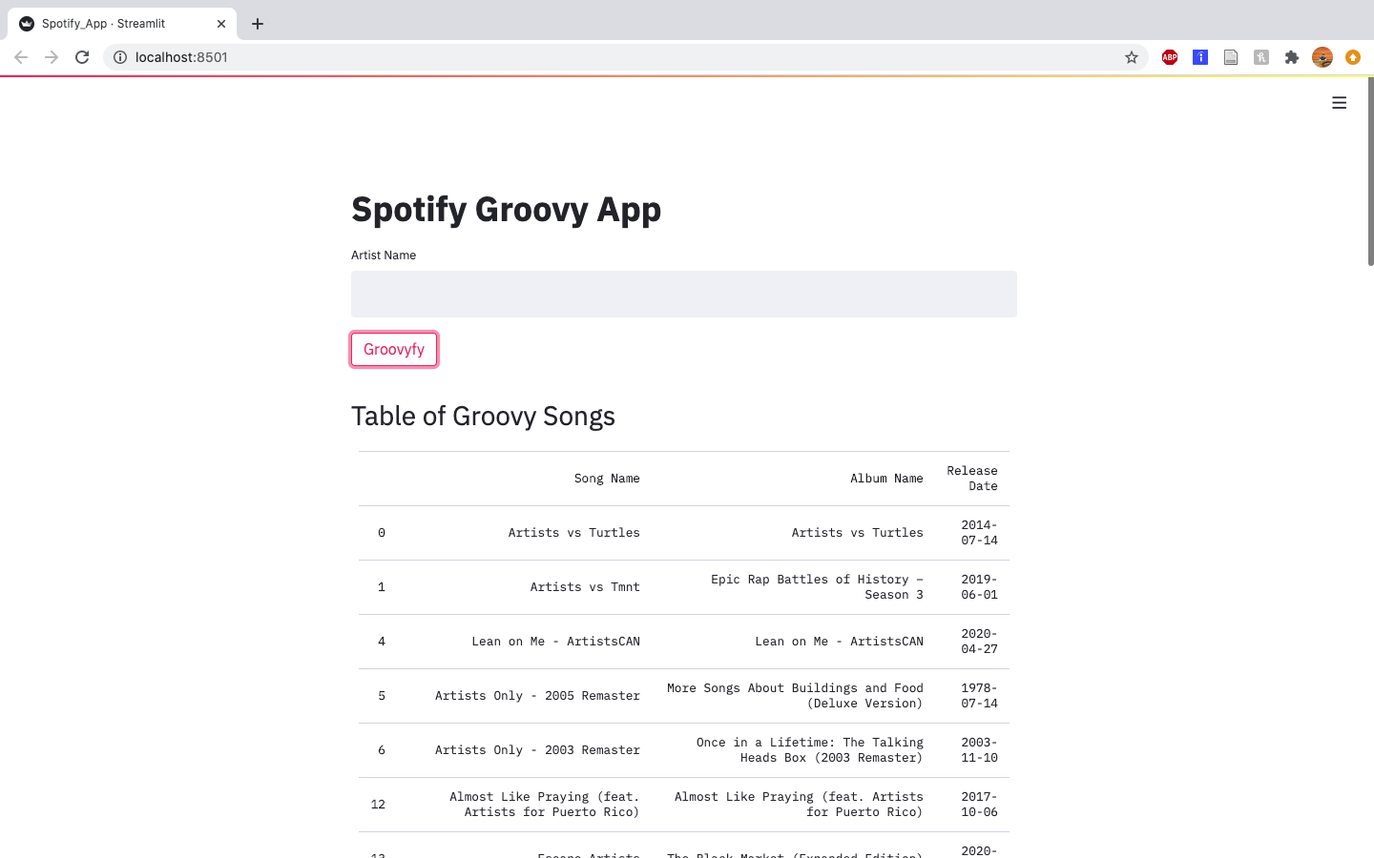
Created a WebApp that Returns a List of “Groovy” Songs by an Artist
Notes:
I took that model with the threshold setting and created an app that takes in an artist and gives you their songs that are groovy, so lets demonstrate it

Slide 9
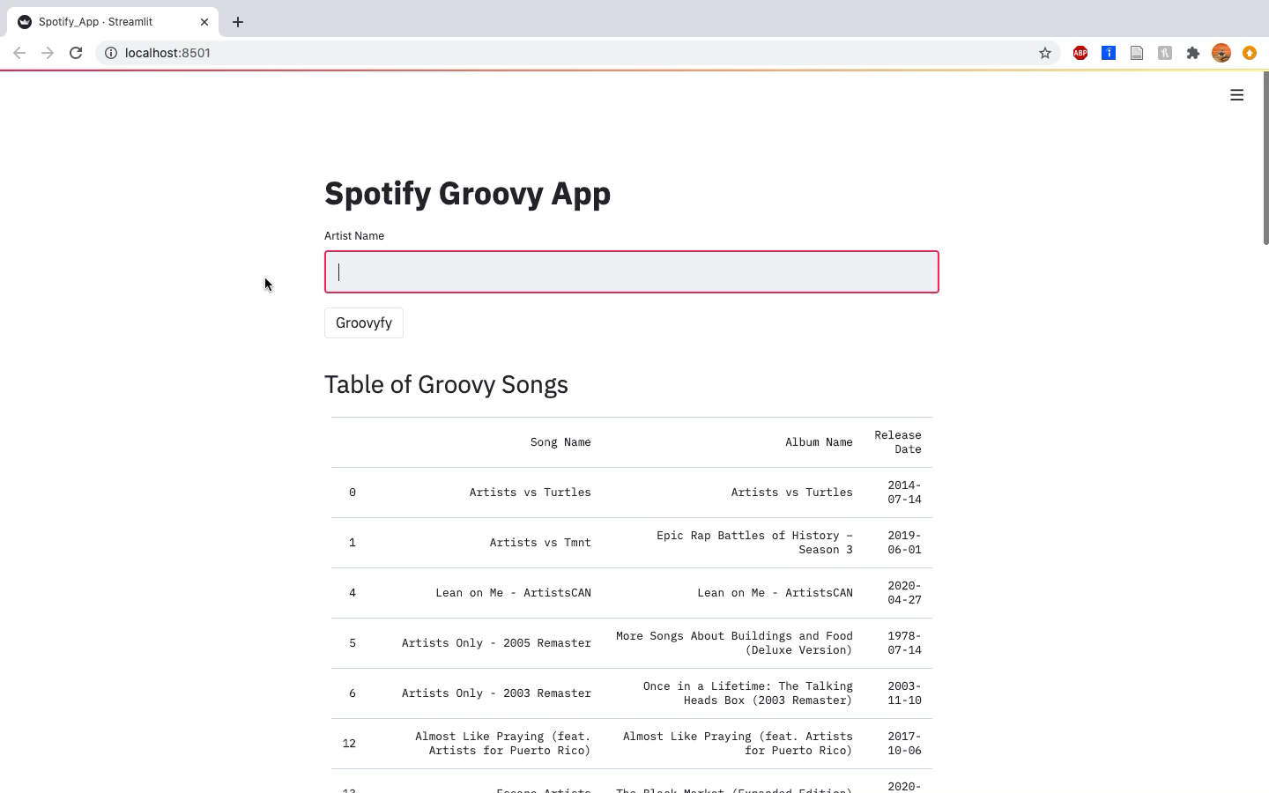
Notes:
From the uc davis study, stevie wonder’s superstitioon was their most groovy song, so lets see. So it gave us a list of his groovy songs, and yep top of the list here is superstition, followed by sir duke. We also have the album name and the release date according to spotify. It looks like about 10 of his songs were considered groovy by model. Just for fun, I added a scatterplot feature, sing how popularity changes with on of the spotify features. So we can choose, say, valence, happy or sad. And we can see that all of stevie’s groovy songs are pretty happy, the less popular ones like part time lover, you can also se the album and release date by hovering. And over here, unsurprisingly is superstion, and sir duke. Down here we have a table of the songs in descending order of popularity, so superstition and sir duke. And you can see the popularity, and the chosen features score, in this case valence. Finally, if you’re curious about what the features mean, you can see down here. So I hope people can find use out of the app, and maybe have a little fun exploring

Slide 10
Future Considerations
Precision Provides Limited Number of Songs
Explore and Gather More Features
Improve WebApp
Playlists
Notes:
For future considerations, obviously precision is important, but obviously can be limited if you don’t have a large dataset to begin with, to improve the model, of course more features would help, like perhaps bass repetitiveness or specific timbre. Lastly, what I would love to figure out is how to work with the spotify api to plug in a playlist, and have it spit out a new playist of just the groovy songs, ao that project is next. And with that.

Slide 11
Questions?

